Slide 1
Design Pattern
Reedwanul Islam © 2015

Slide 2
Refferences
Software design pattern, url: https://en.wikipedia.org/wiki/Software_design_pattern
Design Patterns, authors; Erich Gamma, Richard Helm, Ralph Johnson and John Vlissides
Design Patterns, url: https://sourcemaking.com/design_patterns
Structural pattern, url: https://en.wikipedia.org/wiki/Structural_pattern

Slide 3
What is Design pattern?
In software engineering, a design pattern is a general reusable solution to a common occurring problem within a given context in software design [1].

Slide 4
Type of Design pattern
Name | Description
Creational Pattern | Creational pattern dictates how objects are create, composed and represented in the system [2]. This patterns are mostly use for class instantiation [3].
Structural Pattern | Structural patterns use to describe how classes and objects are composed [2]. This pattern help us to identify the relationship between objects [4].
Behavioral Pattern | Patterns that are use to communication between objects. This patterns are use to distribute responsibilities classes. [2]

Slide 5
Creational Patterns
Dictate system how to create classes.
Hide system’s class creation from outside view.
This pattern is very important for systems evolve.

Slide 6
Type of Creational patterns
Name | Description
Abstract Factory | Create an instance of group of classes.
Builder | Separate object construction from its representation.
Factory Method | Allow subclass to decide which class to create base on pre defined interface.
Prototype | Create an new object by coping prototypical instance.
Singleton | Ensure a class only has one instance and provide global point of access to it.

Slide 7
Structural Pattern
Create composition between classes and objects.
Create new functionality by composing objects together.
Allow to change object composition on run-time.
Describes how to build class hierarchy.
Allow program to create class effectively and have consistency among the creation.

Slide 8
Type of Structural Pattern
Name | Description
Adapter | Adapter lets classes work together that couldn’t otherwise because of incompatible.
Bridge | Separates an object’s interface from its implementation.
Composite | A tree structure of composite objects to show hierarchies.
Decorator | Add extra responsibilities with an object dynamically.
Façade | Provide a unified interfaced for all the subsystems.
Flyweight | Support large numbers of objects efficiently.
Proxy | An object represent another objects.

Slide 9
Behavioral Pattern
Describe the communication between the objects.
Show how objects are interconnected.
It characterize complex flow of the system.
Describe how group of objects solve a task.

Slide 10
Type of Behavioral Pattern
Name | Description
Chain of Responsibility | A way of processing a request between a chain of objects.
Command | Encapsulate a request as an object.
Interpreter | Introduce grammar of the language.
Iterator | Allow to access the object without expositing its underlying representation.
Mediator | Defines simple communication between classes.
Memento | Capture and restore an object’s internal state
Observer | Create two communication between objects. When one object changes all the other dependent object gets notified.

Slide 11
Type of Behavioral Pattern
Name | Description
State | Allow object to alter its behavior when its internal state changes.
Strategy | Define a family of algorithms, encapsulate each one and make them interchangeable.
Template Method | Define exact steps of an algorithm to a subclass.
Visitor | Represent an operation to be performed without change the object.

Slide 12
Abstract Factor
Create an instance of group of classes.
Creational pattern.

Slide 13
When to use?
When system has multiple families of products.
Family of product will be used together.
Family of products need to use sub products to work.

Slide 14
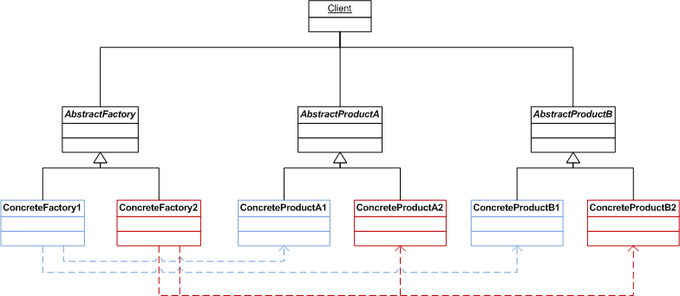
Structure

Slide 15
Structure
In abstract factory pattern client will only aware about the interface knowledge about the product.
Here is the sample of client code example;
AbstractFactory factory = new ConcreteFactory1();
AbstractProductA productA = factory.GetProductA();
productA.DoSomething();
AbstractProductB productB = factory.GetProductB();
productB.DoSomething();

Slide 16
Example
Problem definition:
A bank offers two different account type, Local and International. Local account only allow customer transfer money locally but international account allow customer to do transaction internationally. Both account allow customers to deposit, withdrew and check transaction.

Slide 17
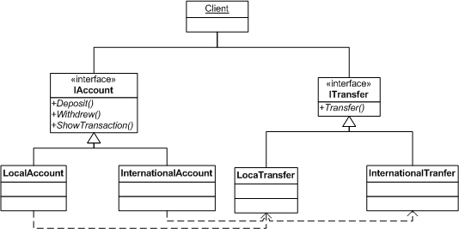
Example

Slide 18
Example
Client code;
IAccount account;
If(CreateLocal)
{
account = new LocalAccunt();
}
Else
{
account = new InternationalAccount();
}
ITransfer transfer = account.GetTransfer();
transfer.Transfer();

Slide 19
Builder
Separate object construction from its representation.
Creational design pattern

Slide 20
When to use?
Create a complex object that depends upon its independent parts.
When single object can act differently base on its creation.
If object constructor need large number of optional parameters.

Slide 21
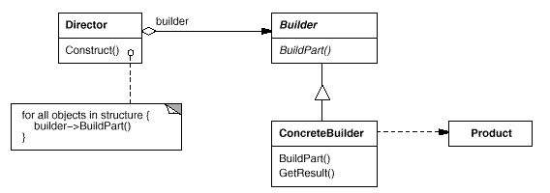
Structure

Slide 22
Example
Problem definition:
For each of our food product we have nutrition chart. But each product nutrition value is different. Some product may have vitamin C some may not. Client may pick any product and like to see the nutrition value of the product. For example client code may looks like;
IProduct food = new Orange();
INutrition n = food.GetNutrition();
n.Show();

Slide 23
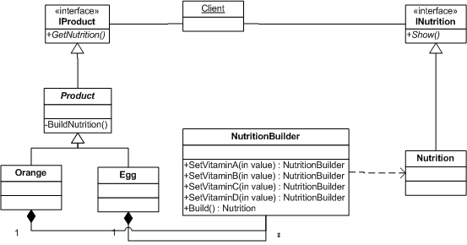
Example

Slide 24
Example
Build nutrition for Orange;
Nutrition n = new NutritionBuilder()
.SetVitaminA(1%)
.SetVitaminC(94%)
.Build();

Slide 25
Example
Build nutrition for Egg;
Nutrition n = new NutritionBuilder()
.SetVitaminA(10%)
.SetVitaminC(0%)
.SetVitaminD(15%)
.Build();

Slide 26
Façade
Provide a unified interfaced for all the subsystems.
Structural design pattern.

Slide 27
When to use?
Provide simple interface for a complex system.
If system has multiple layer.
Many dependencies between clients and the implementation classes.

Slide 28
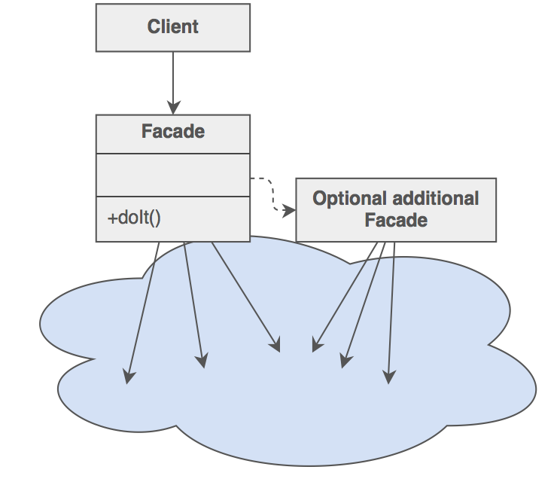
Structure

Slide 29
Example
Problem definition;
In an airlines company if a customer agent create a ticket or changes any existing ticket then the system must let operation group know about the change. Also system will update billing information to the account system. If change occurs in any travel agent’s ticket then system will also notify the change to travel agency system.

Slide 30
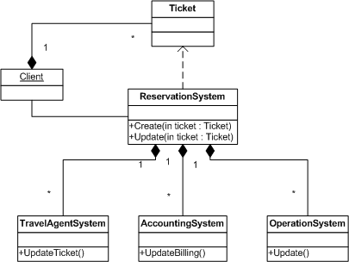
Example

Slide 31
Example
Code example for Reservation system create ticket;
OperationSystem os = new OperationSystem();
os.Update();
AccountingSystem as = new AccountingSystem();
as.UpdateBilling();

Slide 32
Example
Code example for Reservation system update ticket;
OperationSystem os = new OperationSystem();
os.Update();
AccountingSystem as = new AccountingSystem();
as.UpdateBilling();
If(this.ticket.IsTATicket())
{
TravelAgentSystem tas = new TravelAgentSystem();
tas.UpdateTicket();
}

Slide 33
Flyweight
Support large numbers of objects efficiently.
Structural design pattern.

Slide 34
When to use?
When a system use large number of objects.
Many groups of objects may be replaced by relatively few shared objects.
Application stays independent from object identification.

Slide 35
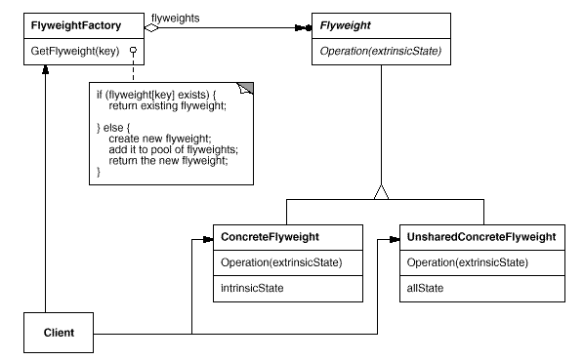
Structure

Slide 36
Example
Problem definition;
Given historical data of an storm movement our system will identify were approximately storm will effect. To predict storm track we have multiple algorithm that we can use.

Slide 37
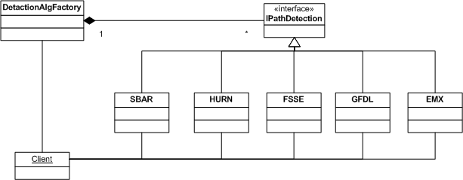
Example

